Slide 1
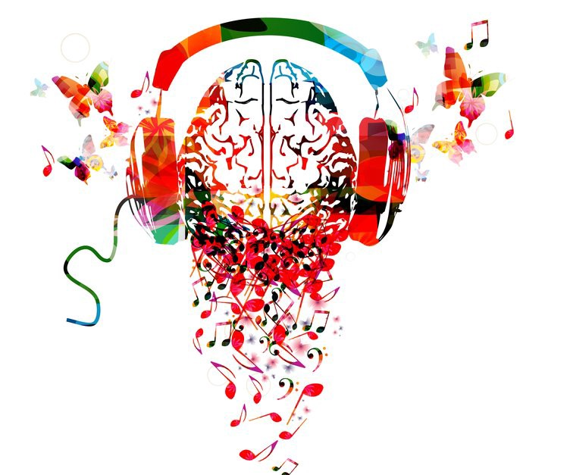
The Effect of Familiarity on EEG
Kaushika Uppu, Zairan Xiang, Duc Vo

Slide 2
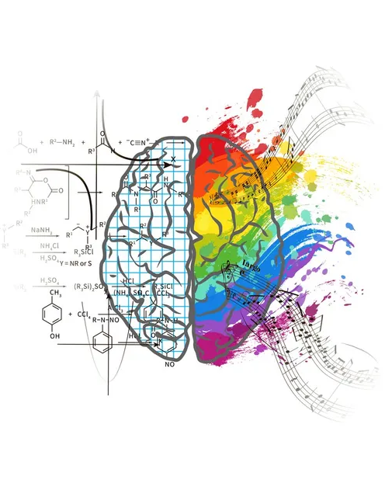
Introduction and Motivation
How does a person’s familiarity with a piece of music affect the brain?
The familiarity of a song might be correlated with one’s emotional response and attention while listening
Does a familiar song elicit a greater response in the frontal lobes due to increased attention?
People often play music while studying or working, and examining the brain’s response to familiarity could aid in choosing the right type of music to be more focused
Kaushika
Notes:
The main question we tried to answer with this project was “How does a person’s familiarity with a piece of music affect the brain?” Our motivation for this question stemmed from the idea that the familiarity of a song could be correlated with a person’s emotional response and attention in the brain to that song. People often tend to listen to music while studying or working or while doing other activities, so examining the brain’s response to familiarity could aid in choosing the right type of music to be more focused.

Slide 3
Related Work
Music and Emotions in the Brain: Familiarity Matters
Pereira, C. E., Teixeira, J. A., Figueiredo, P., Xavier, J., Castro, S. L., & Brattico, E. (2011). Music and Emotions in the Brain: Familiarity Matters. PLOS ONE, 6(11), e27241. https://doi.org/10.1371/journal.pone.0027241
Neural Correlates of Familiarity in Music Listening: A Systematic Review and a Neuroimaging Meta-Analysis
Freitas, C., Manzato, E., Burini, A., Taylor, M. J., Lerch, J. P., & Anagnostou, E. (2018). Neural Correlates of Familiarity in Music Listening: A Systematic Review and a Neuroimaging Meta-Analysis. Frontiers in Neuroscience, 12. https://doi.org/10.3389/fnins.2018.00686
Kaushika
Notes:
These were two of the papers that we found that we think were most relevant to our project, specifically focusing on familiarity in the brain. The first is an fMRI study that examines the relationship between familiarity and emotional response with music, while the second is a review that analyzed how familiarity of music affects different brain regions.

Slide 4
Related Work
Mere exposure effect: the more familiar or more exposed to something we are, the more we tend to like it
The N400 wave, an ERP component, is known to be associated with conceptual or semantic processing
Familiar music, when compared to unfamiliar music, resulted in a larger N400 wave in frontal regions, which could be a result of increased attention due to increased emotional processing
Kaushika
Notes:
From these two papers, one of the main things that we learned was the mere exposure effect, which is especially important when it comes to familiarity, as it states that the more familiar or more exposed to something we are, the more we tend to like it. This therefore links familiarity with emotion, which was something that our motivation for this project is based on. In addition, the N400 wave is an ERP component, and is known to be associated with conceptual or semantic processing in the brain. Finally, from the second paper, we learned that familiar music, when compared to unfamiliar music, resulted in a larger N400 wave, specifically in frontal regions, which could be the result of increased attention due to increased emotional processing, which is what we hypothesize our EEG data will show.

Slide 5
Methods: General Overview
Research Question: How does the familiarity of a song affect one’s EEG?
Basic Plan:
Create music stimulus with combination of 10 familiar and unfamiliar music snippets geared towards each participant
Record EEG using OpenBCI Cyton while playing stimulus out loud
Compare the EEG results from both participants across familiar and unfamiliar songs
Kaushika
Notes:
For methods, our basic plan for this project was to create a music stimulus with a combination of a total of 10 familiar and unfamiliar music snippets, which was specifically geared towards each participant. Then, we would record EEG data from the participant using the OpenBCI Cyton while playing the music stimulus out loud. Finally, we would compare the EEG results from both participants across familiar and unfamiliar songs to analyze the similarities and differences.

Slide 6
Methods: Design
Participants: 2 UCSD students
Stimulus:
Created using iMovie, 15-second snippets were taken from each song (5 familiar, 5 unfamiliar), with order randomized by coin flip
5 seconds of silence inserted in between each snippet
Familiar song chosen by participants, unfamiliar song chosen by tester
all songs within the pop genre
Kaushika
Notes:
The participants in our project were two UCSD students. The music stimulus was created using iMovie, with 15-second snippets taken from each song, 5 being from the familiar song and 5 being from the unfamiliar song. The order of presentation of these snippets was randomized by coin flip. Between each of the 15-second snippets, 5 seconds of silence was inserted to separate the snippets. The familiar song was chosen by the participants, while the unfamiliar song was chosen by the tester, but all songs used in the project were within the pop genre with a similar sound.

Slide 7
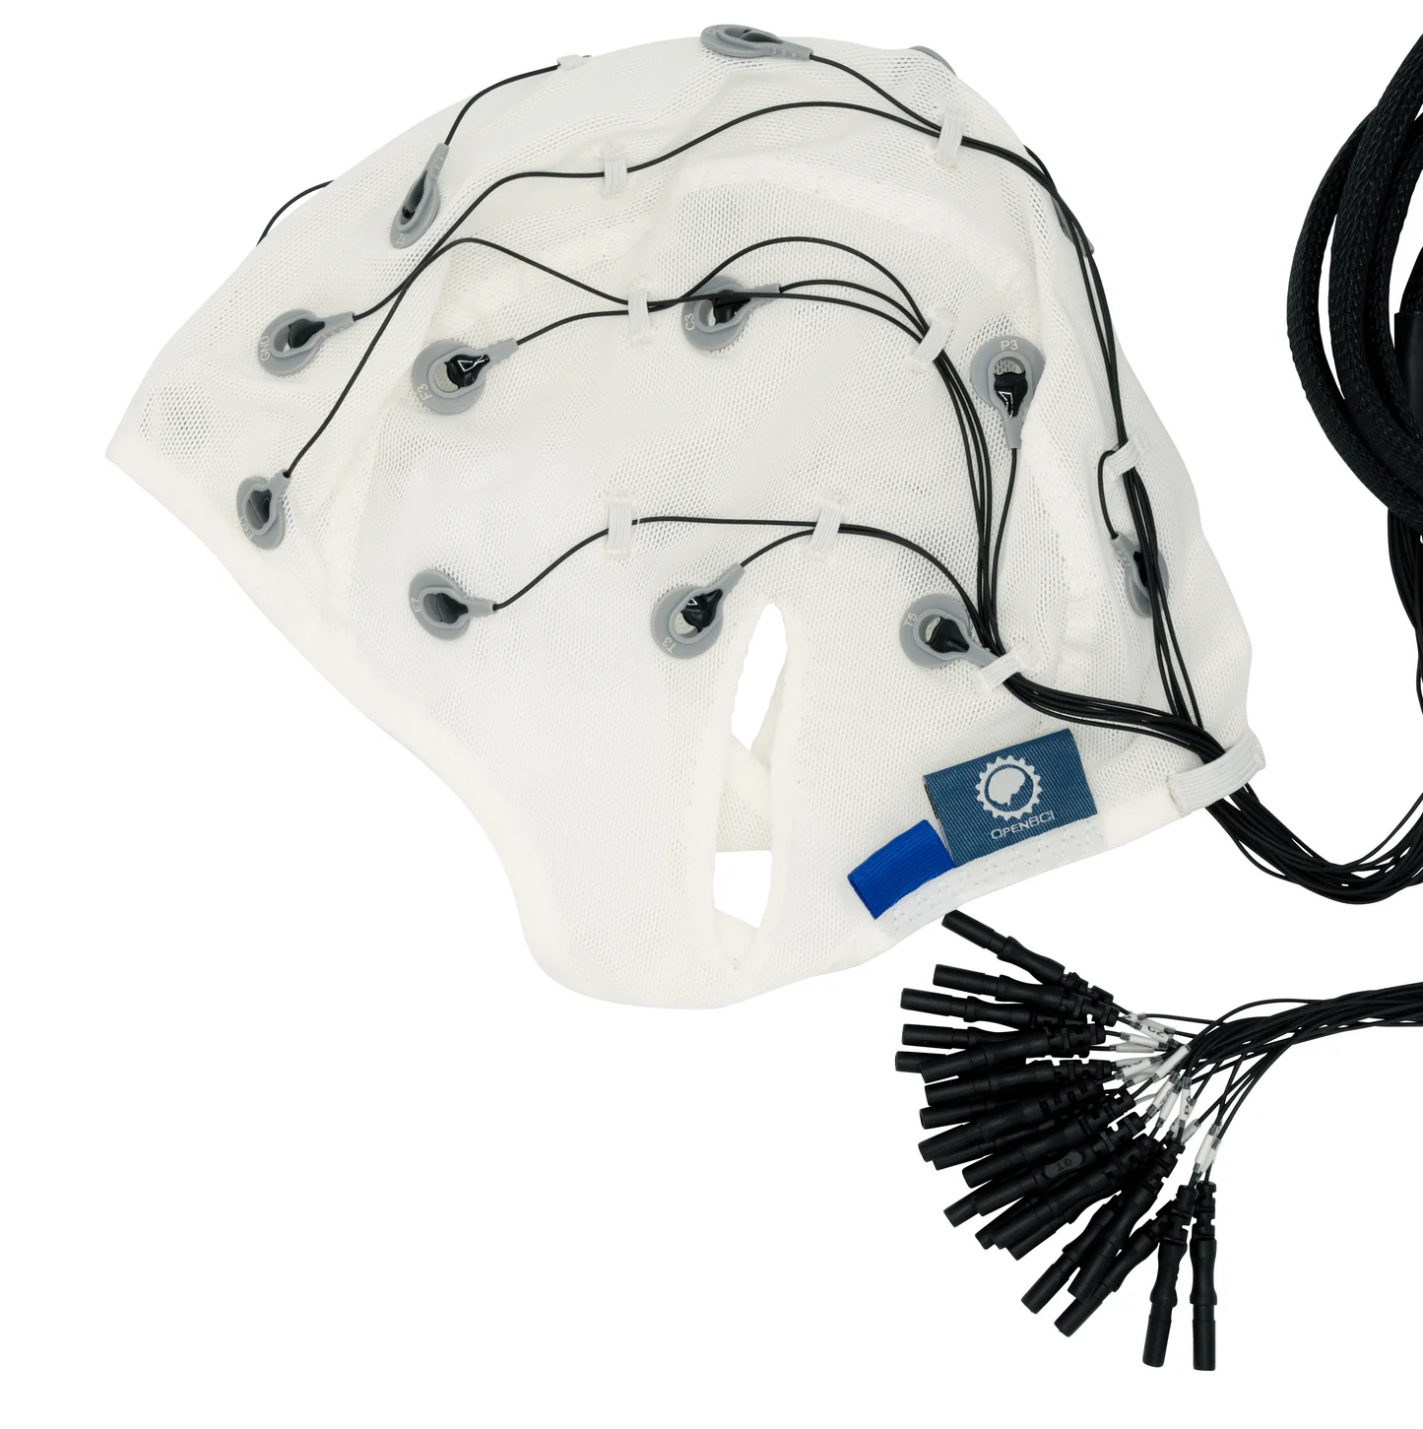
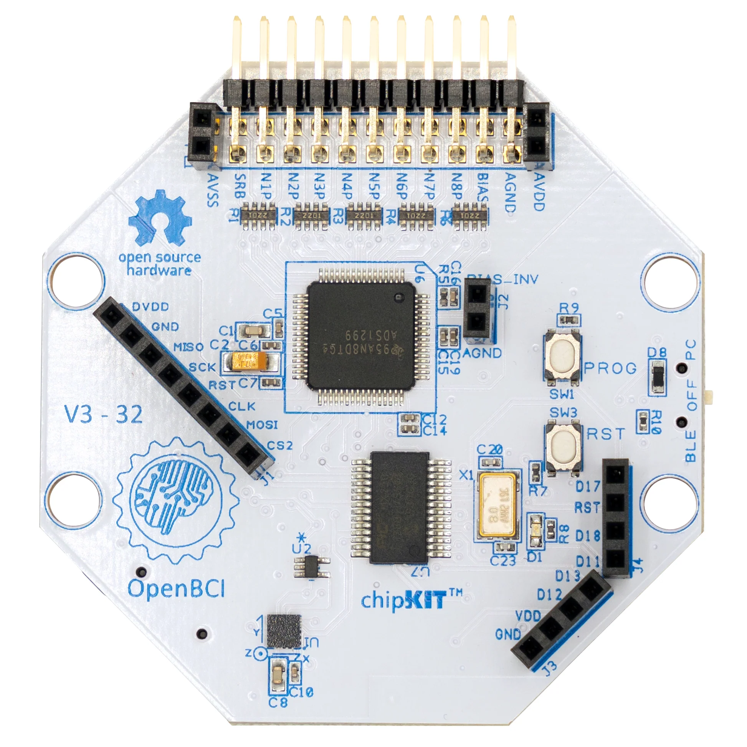
Methods: Design
Procedure:
Participant fitted with EEG cap and electrodes were connected to the OpenBCI Cyton
Channels used for data collection: ‘Fp1’, ‘F3’, ‘Fz’, ‘F4’, ‘T3’, ‘C3’, ‘Cz’, and ‘T4’
Ground electrode placed at ‘AFz’ and reference placed at ‘CPz’
Music stimulus was played while the participant sat still in a chair in front of the laptop being used for data acquisition
The period of music playing was manually marked on the OpenBCI GUI through the Cyton, by pressing the button for channel D17
Kaushika
Notes:
Finally, for the procedure, the participant was fitted with an EEG cap and electrodes were connected to the Cyton. The channels that we used for data collection were Fp1, F3, Fx, F4, T3, C3, Cz, and T4, as we specifically wanted to collect data from the frontal and temporal lobes for this project. The group electrode was placed at AFz, and the reference electrode was placed at CPz. After this was all set up, the music stimulus was played while the participant sat still in a chair in front of the laptop being used for data acquisition. Each 15-second period of music playing was manually marked on the OpenBCI GUI through the Cyton itself, by pressing the button for channel D17.

Slide 8
Analysis: Convert Raw Data
The format of the data we recorded using OpenBCI was a .txt file. To process and analyze the data, we used Python to transform the data.
converted the text file to a data vector with shape (10, 175, 8)：
10 trials (5 w/ familiar music; 5 w/ unfamiliar music)
175 data in each trial (15 sec)
8 channels ‘Fp1’, ‘F3’, ‘Fz’, ‘F4’, ‘T3’, ‘C3’, ‘Cz’, and ‘T4’
Zairan
Notes:
Use positive first derivative to determine onset (the moment we start to have music playing), and Epoch based on that

Slide 9
Analysis: Pre-Processing
Band pass filter
(we used a non-causal, zero-phase filter signal.filtfilt)
sampling rate of 250Hz
low cutoff frequency: 0.1 Hz
high cutoff frequency: 30 Hz
Epoch: 0ms before onset, and 700ms after onset
Baseline correct
Zairan
Notes:
Epoch: Use positive first derivative to determine onset (the moment we start to have music playing), and Epoch based on that

Slide 10
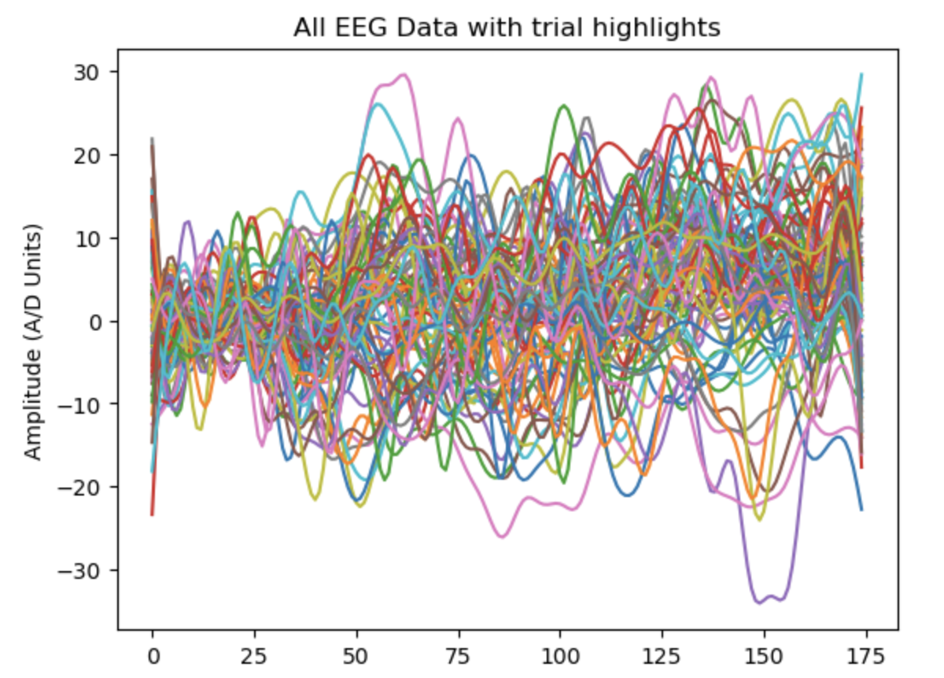
Analysis: Pre-Processing
there are not too many large noise artifacts:
Zairan

Slide 11
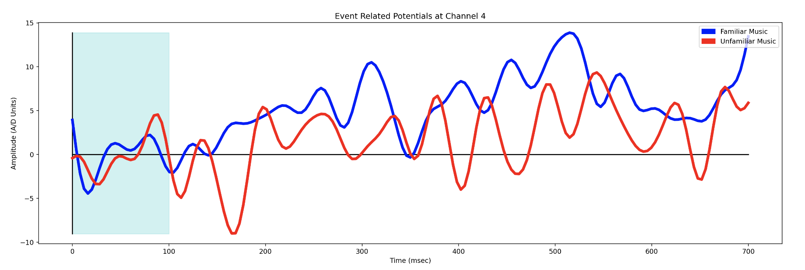
Analysis: Plot ERP
ERP: short segments of EEG data that are time-locked to music-playing events of experimental interest, and averaged over 5 trials of a session.
Take the average of all trials to create an averaged ERP and plot each channel for familiar and unfamiliar music.
Example of T3 channel of Participant #2
Zairan

Slide 12
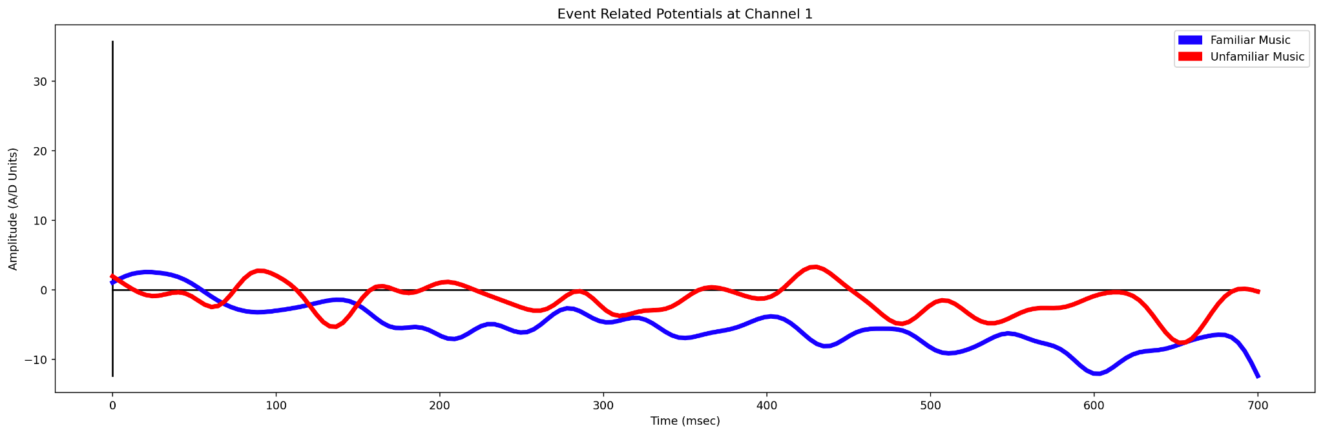
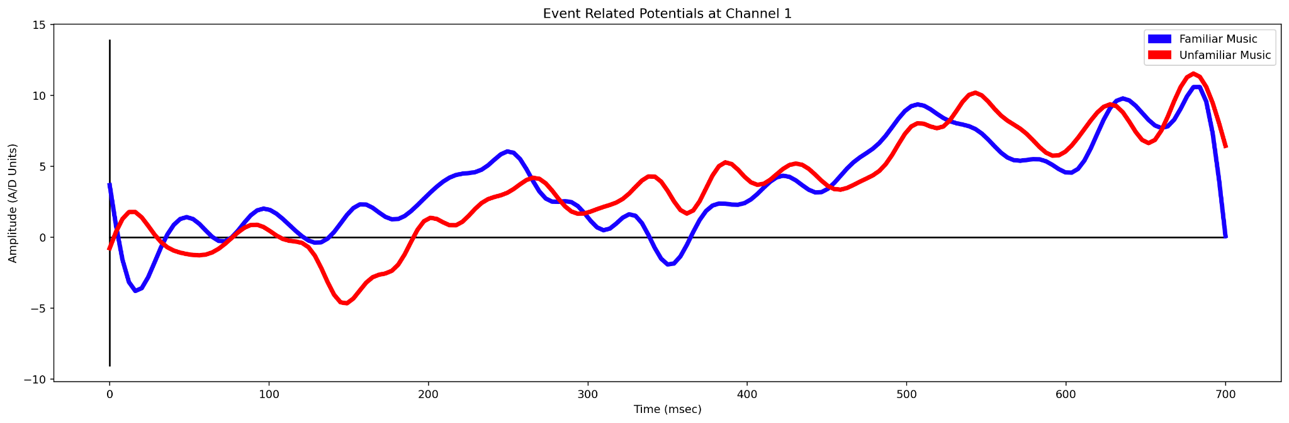
Results - N400 waves
Channel F3
Participant #1
Participant #2
Duc
Notes:
Using the study from one of our related work that we've discussed earlier called Neural Correlates of Familiarity in Music Listening: A Systematic Review and a Neuroimaging Meta-Analysis, the study states found familiar music resulted in a N400 wave which ranges 200-600 ms after the stimulus, but since we only have limited data in our experiment our N400 wave may not be very accurate. Additionally, the n400 wave is bigger in the familiar music in the frontal region of the brain, which could correlate to semantic processing. This could be associated with increased processing of emotions or semantics associations w/the songs’ melody. Overall, the study showed increase in attention in frontal brain regions, around 400 ms when listening to familiar music. We can see this behavior in our experiment in which examined the 2 frontal channels - F3 and F4 and analyzed their N400 wave as shown in the green circle.

Slide 13
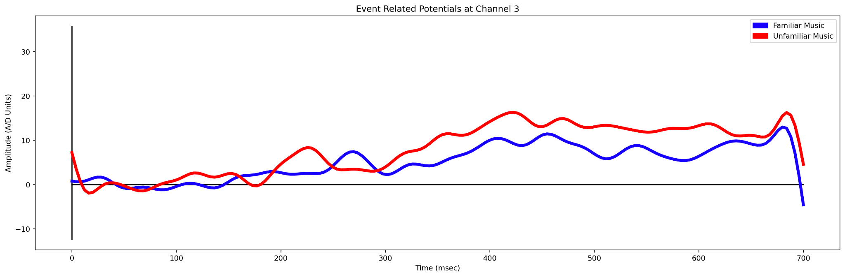
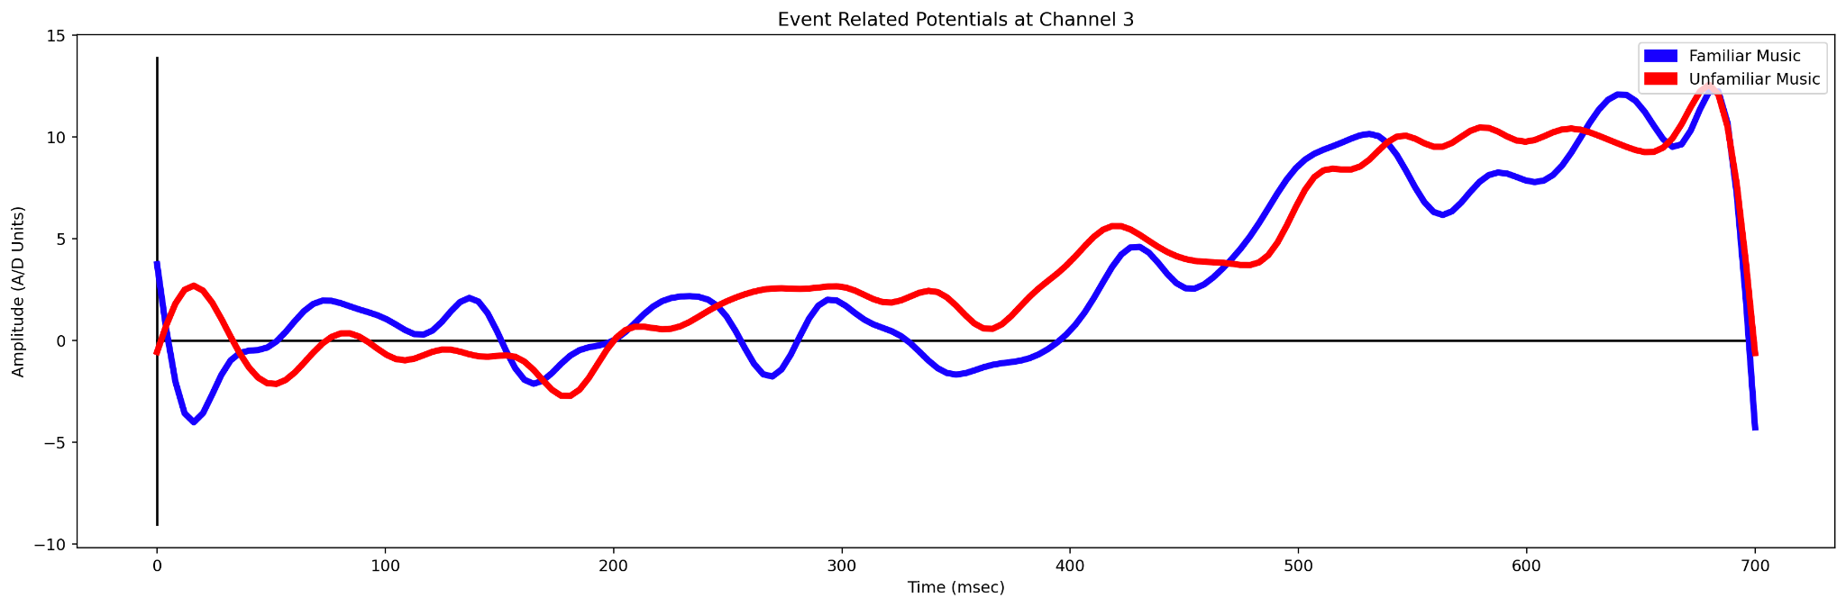
Results - N400 waves
Channel F4
Participant #1
Participant #2
Duc
Notes:
Again, we can see a similar behavior in channel F4 of the frontal region in which displays a N400 wave around 400 ms.

Slide 14
Results - Discovery
The frontal channels exhibited a greater N400 ERP component for snippets of familiar music when compared to snippets of unfamiliar music
This therefore could suggest that familiar music results in increased semantic processing due to processing of emotions and/or semantic associations linked to the song
This is what we expected to see as familiar songs would have a greater likelihood of an emotional connection
What went wrong: we had very little data to work with, and therefore, the ERP might not be highly accurate
Duc
Notes:
For what went wrong, we’ll go into more details in the improvement section later for part of our discussion.
(according to the mere exposure theory) - emotional connection

Slide 15
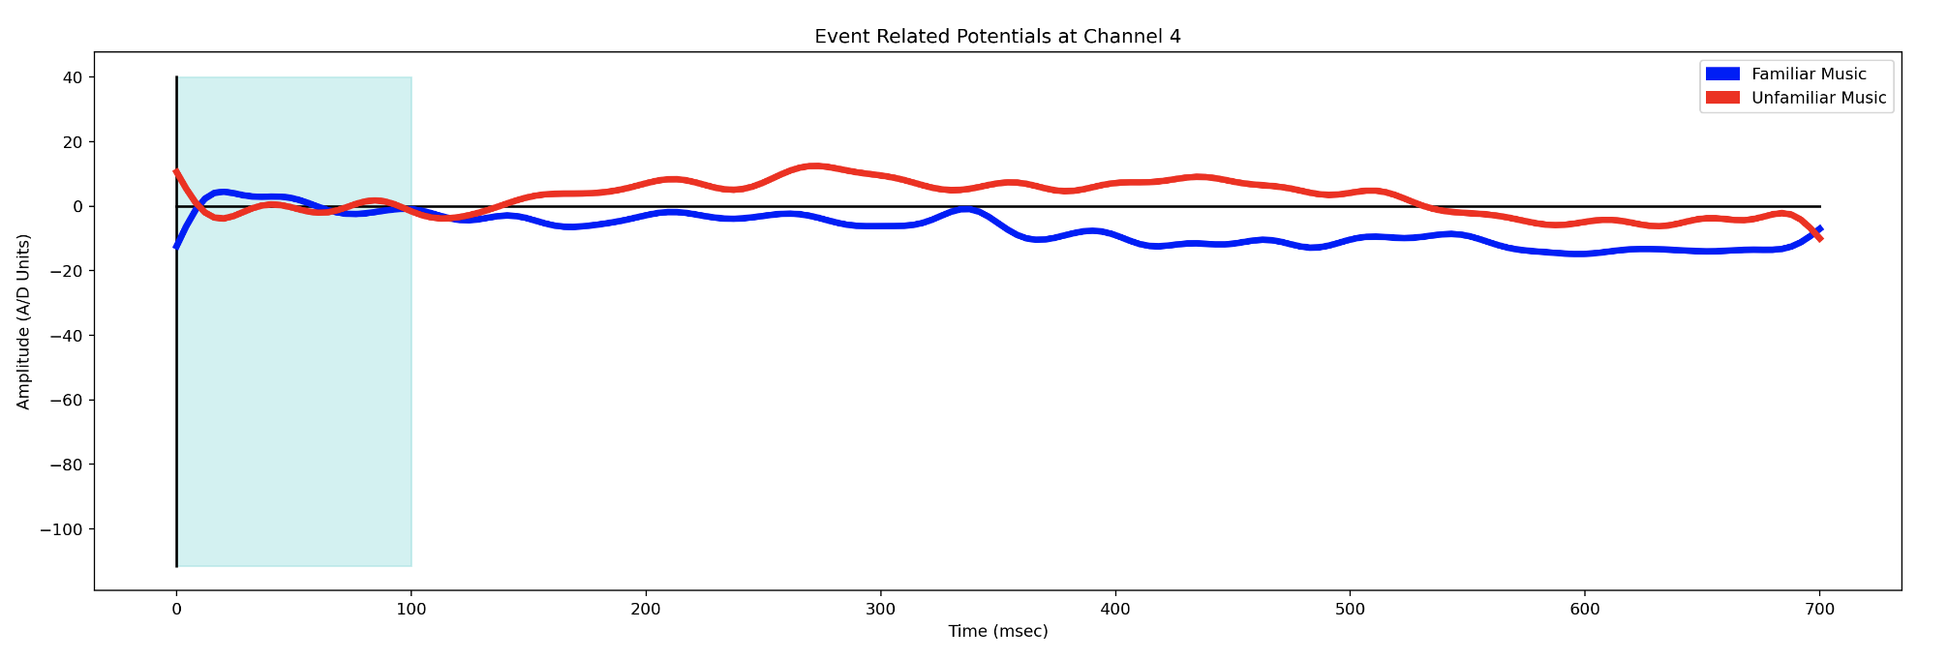
Results - Difficulties
We had to redo Participant #1’s data collection
One of the problems that we ran into on the first day of recording was coordinating the music stimulus without pre-recording it
There was also something wrong with the EEG recording itself, as the data seemed to not be collected properly on the first day
It was difficult for us to perform artifact filtering since we had trouble figuring out which data points in channel Fp1 are considered as artifacts.
Duc

Slide 16
Discussion - What did we learn?
We learned how to properly design an EGG experiment, set up a procedure for testing, and collect EGG data using OpenBCI
Evaluate ERP data and waveforms by analyzing the relationship between time vs. amplitude
Use Jupyter Notebook and Python to pre-process our data through filtering and epoching
Greater N400 waves in frontal regions for familiar music compared to unfamiliar music
Duc

Slide 17
Discussion - Improvements
Given more time, we would collect data from a diverse number of participants and/or with more trials so ERPs have better accuracy
Having a more diverse sample of participants help to increase the generalizability of findings between different demographics, like age, gender, and culture
Control for differences in music stimuli better, such as factors like BPM, so there are no confounding variables
Minimize environmental noise and distractions in the recording room to reduce signal artifacts
Use more of a statistical approach in analysis to test for significance
Duc

Slide 18
Thank you for your time!

